Slide 1
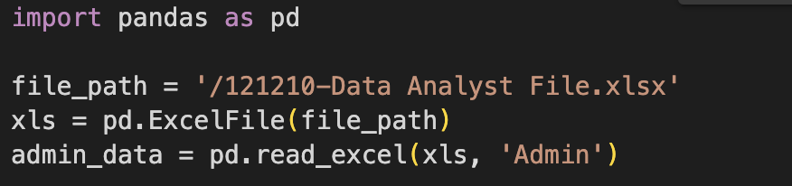
Question 1 - Total Units Utilized Each Month
Step 1
Step 2
Step 3
Step 4
Step 5
Load the admin data:
Step 1
Step 2
Step 3
Step 4
Step 5
Convert 'Admin Date' to datetime:

Slide 2

Question 1 - Total Units Utilized Each Month
Step 1
Step 2
Step 3
Step 4
Step 5
Group by medication and month AND Sum the units for each medication in each month:
Step 1
Step 2
Step 3
Step 4
Step 5
Display Results from Dataframe:

Slide 3
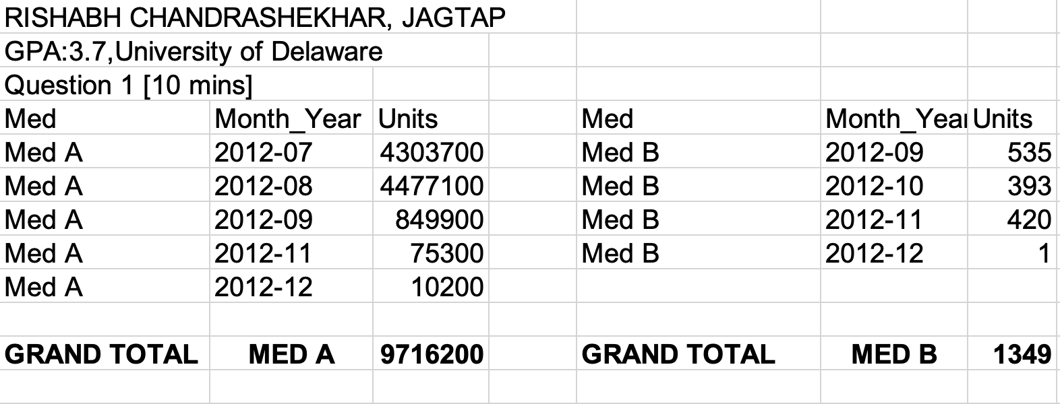
Question 1 - Total Units Utilized Each Month
Step 1
Step 2
Step 3
Step 4
Step 5
Importing the answer in Excel:

Slide 4

Question 2 - Monthly Patient Count
Step 1
Step 2
Step 3
Step 4
Filter admin data for Med A and Med B:
Step 1
Step 2
Step 3
Step 4
Group by month and count unique patient IDs:
Step 1
Step 2
Step 3
Step 4
Tabulate the results for each medication by month:

Slide 5
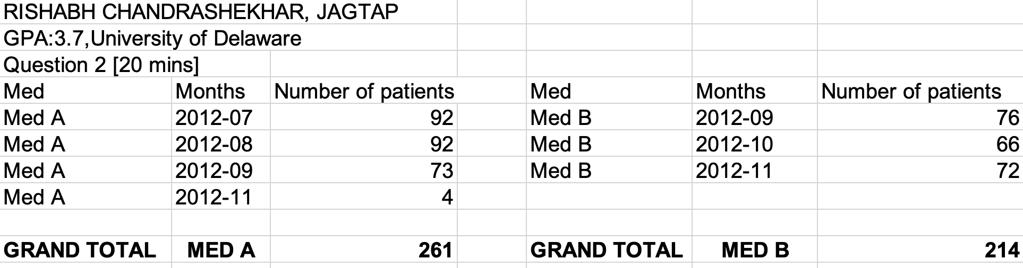
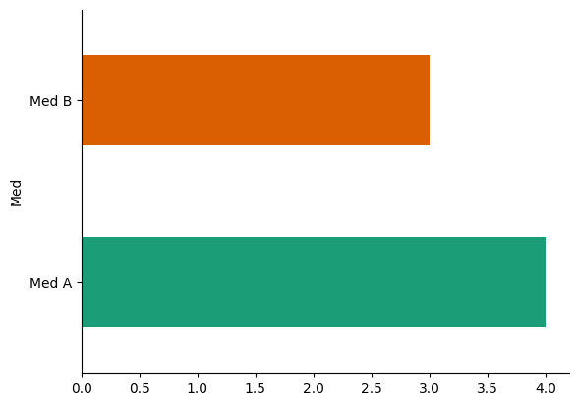
Question 2 - Monthly Patient Count
Step 1
Step 2
Step 3
Step 4
Importing the answer in Excel:

Slide 6
Question 3 - Average Monthly Dose per Patient
Step 1
Step 2
Step 3
Step 4
Filter admin data for the July to November months:
Step 1
Step 2
Step 3
Step 4
Group by patient ID and month, then calculate the total dose:

Slide 7
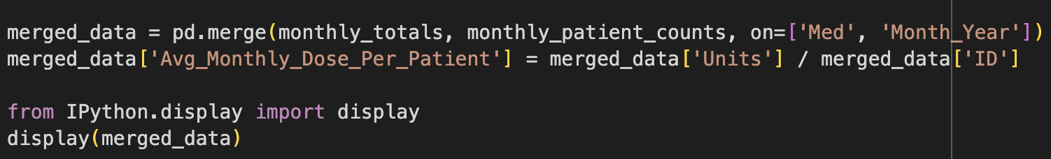
Question 3 - Average Monthly Dose per Patient
Step 1
Step 2
Step 3
Step 4
Compute the average dose per patient for each month and display result:

Slide 8
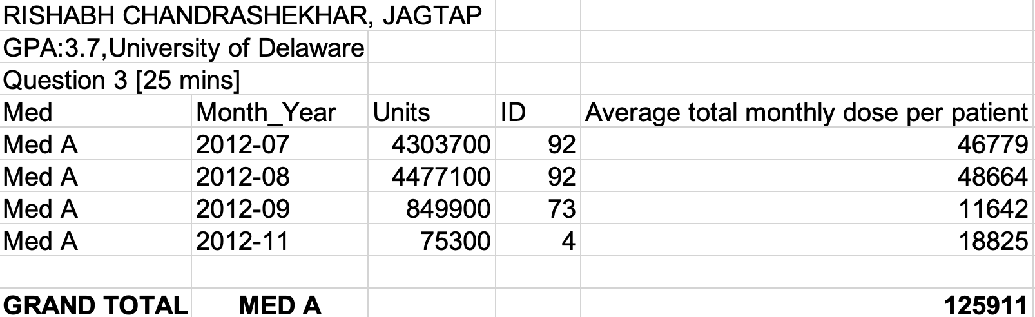
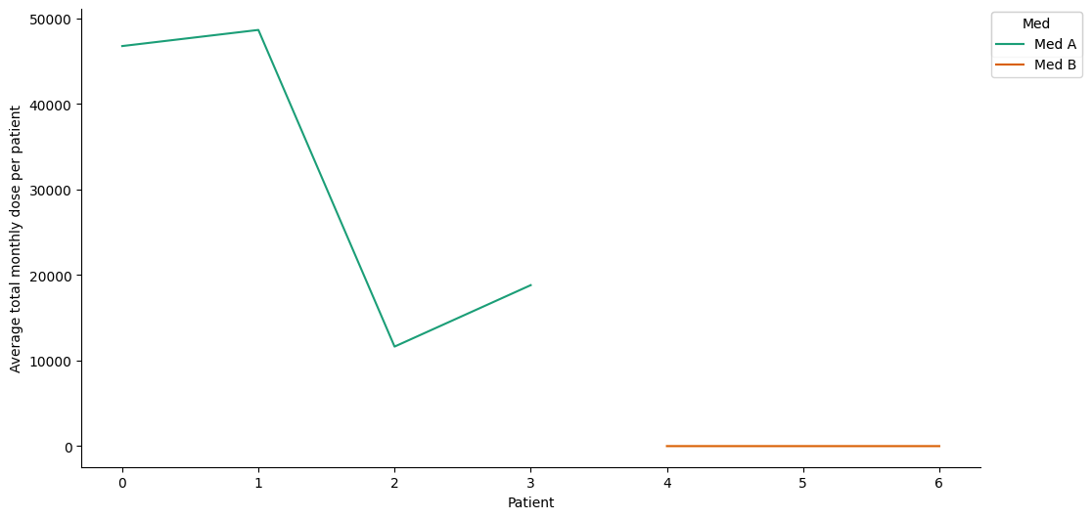
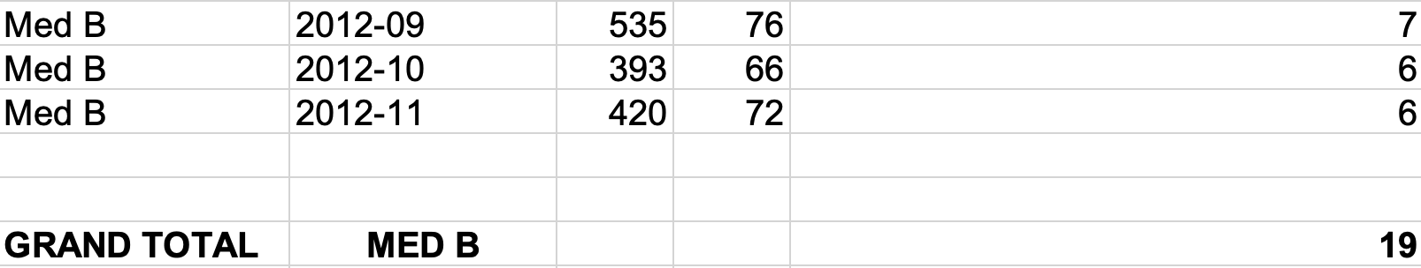
Question 3 - Average Monthly Dose per Patient
Step 1
Step 2
Step 3
Step 4
Importing the answer in Excel:

Slide 9
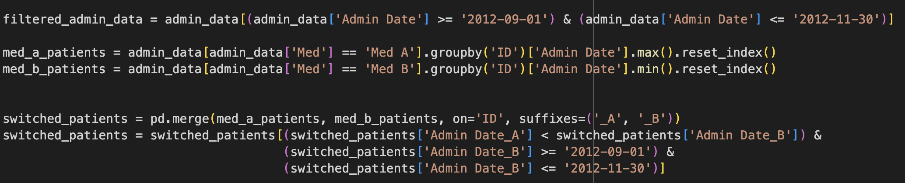
Question 4 - Patients Switched to Med B
Step 1
Step 2
Step 3
Step 4
Filter to identify the switch dates for each patient for each month (Sept, Oct, Nov):

Slide 10
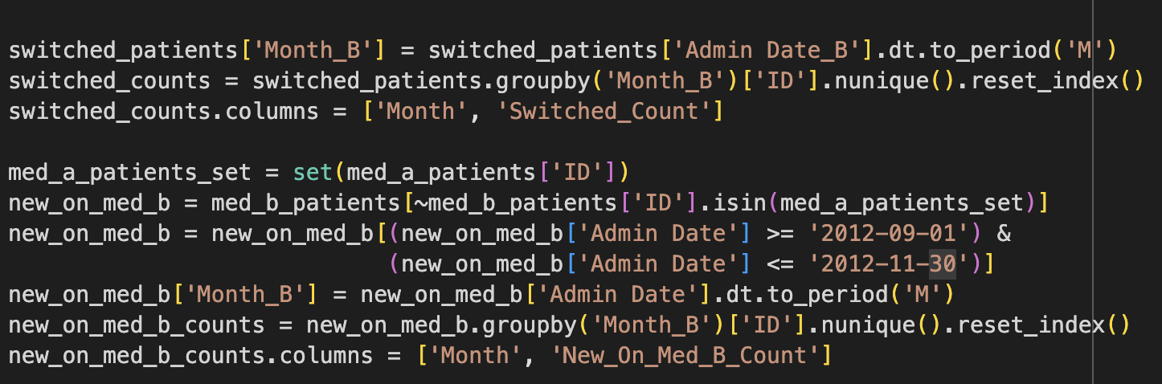
Question 4 - Patients Switched to Med B
Step 1
Step 2
Step 3
Step 4
Count patients who switched each month:

Slide 11
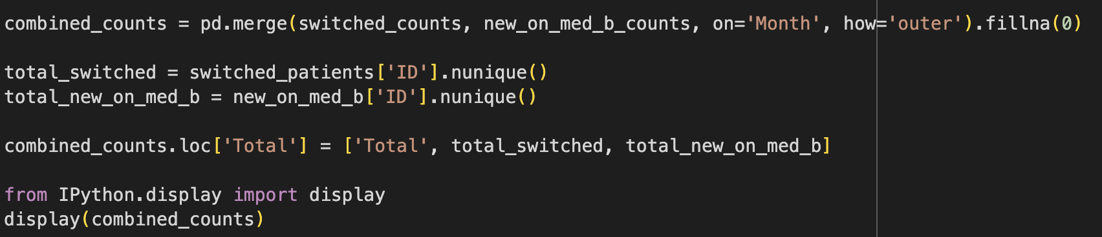
Question 4 - Patients Switched to Med B
Step 1
Step 2
Step 3
Step 4
Identify patients starting on Med B without previous Med A and display the count:

Slide 12
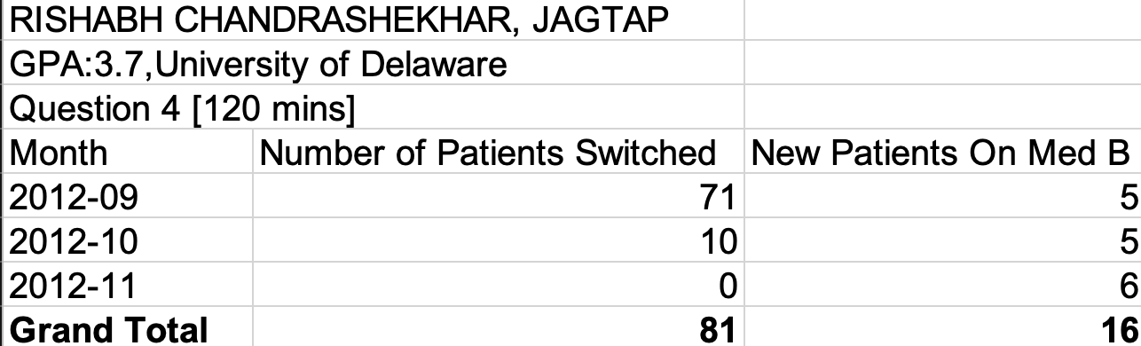
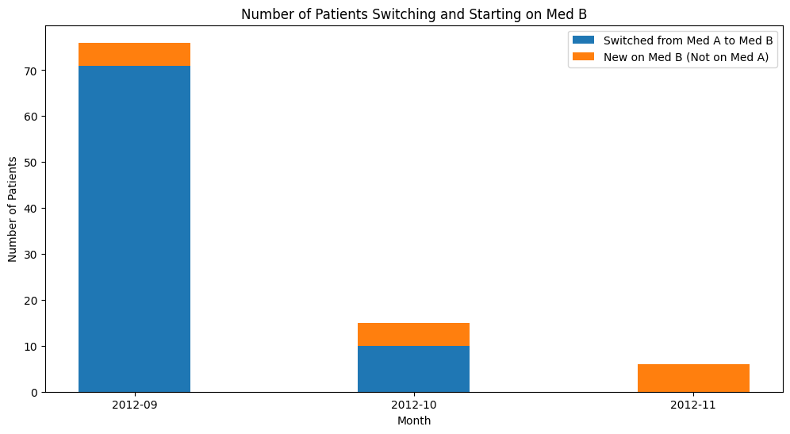
Question 4 - Patients Switched to Med B
Step 1
Step 2
Step 3
Step 4
Importing the answer in Excel:

Slide 13
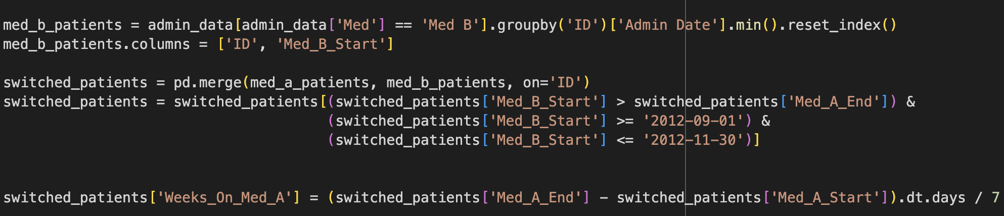
Question 5 - Average Weeks on Med A Before Switching
Step 1
Step 2
Step 3
Step 4
Convert the Months to Weeks : Identify the first administration date for Med B for each patient, Merge the data to find patients who switched from Med A to Med B, Calculate the duration on Med A in weeks for these patients.

Slide 14
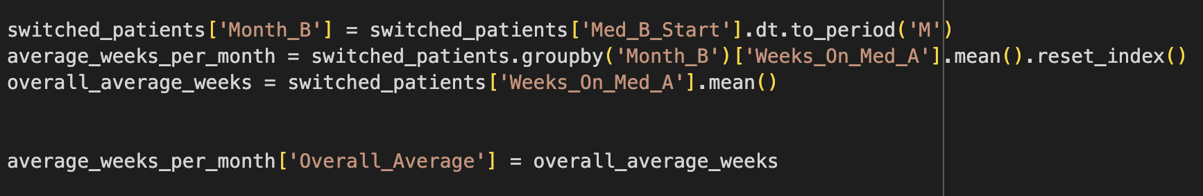
Question 5 - Average Weeks on Med A Before Switching
Step 1
Step 2
Step 3
Step 4
Compute the Average Duration for Patients Switching Each Month : Group the data by the month of switching to Med B .Calculate the average number of weeks on Med A for each month. Compute the overall average duration across all three months.

Slide 15
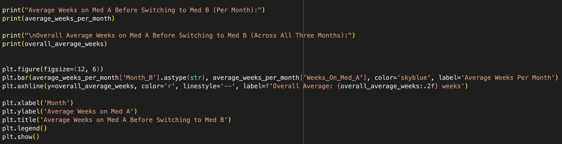
Question 5 - Average Weeks on Med A Before Switching
Step 1
Step 2
Step 3
Step 4
Display the Results in a Table and Plot:

Slide 16
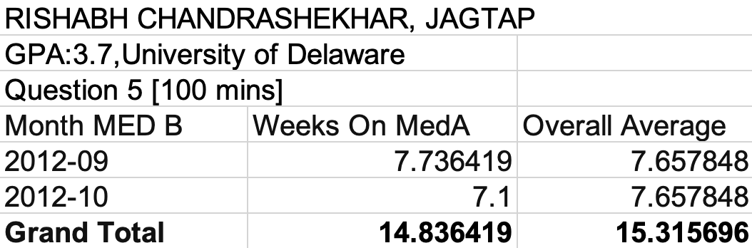
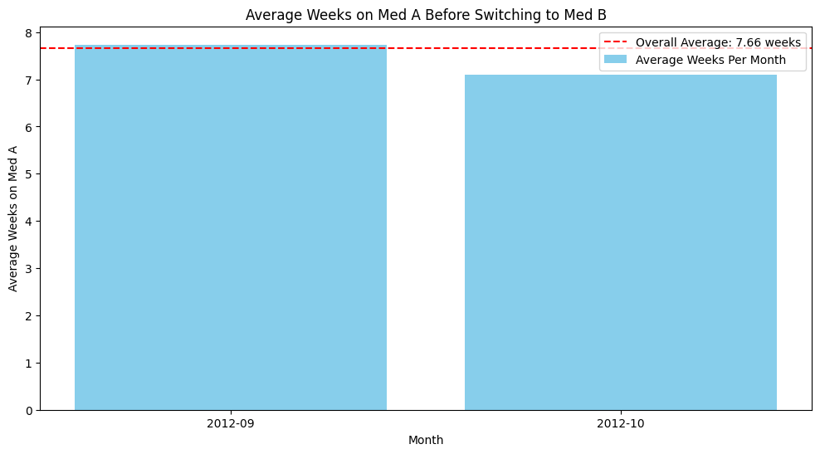
Question 5 - Average Weeks on Med A Before Switching
Step 1
Step 2
Step 3
Step 4
Importing the answer in Excel:

Slide 17
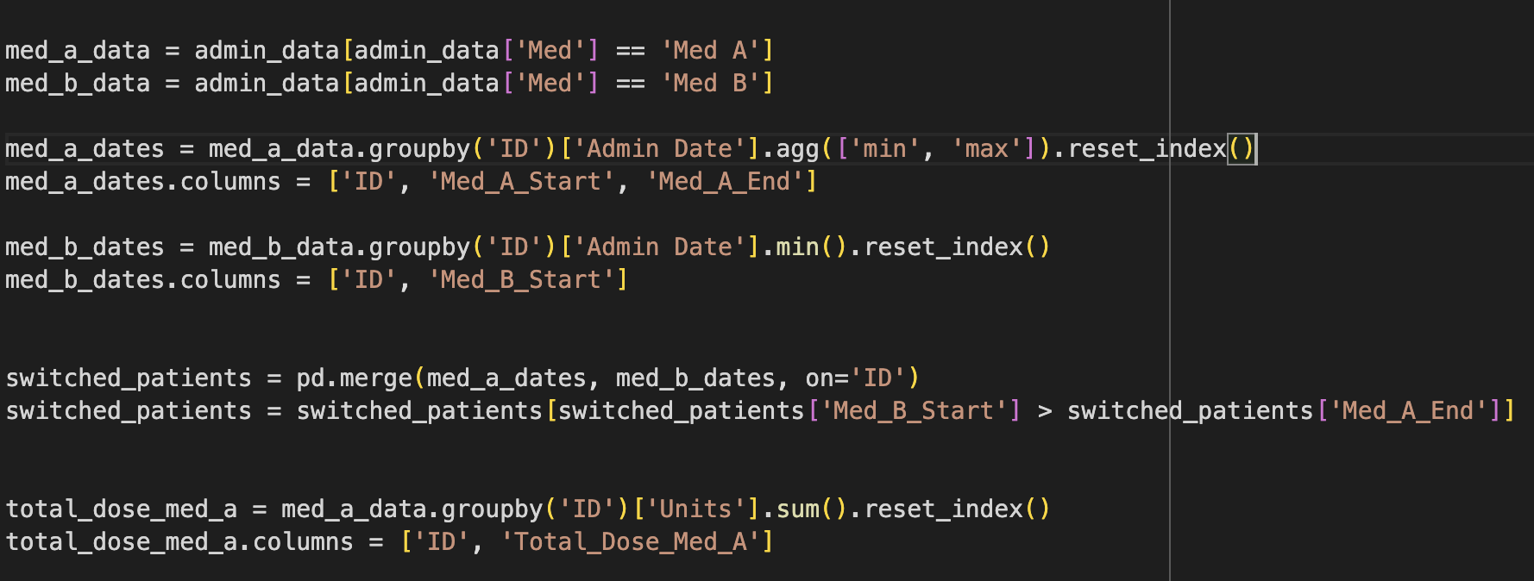
Question 6 - Average Monthly Dose Before and After Switching
Step 1
Step 2
Step 3
Step 4
Step 5
Step 6
Filter the data for Med A. Calculate the start and end dates for Med A administration. Calculate the total dose of Med A for each patient:

Slide 18
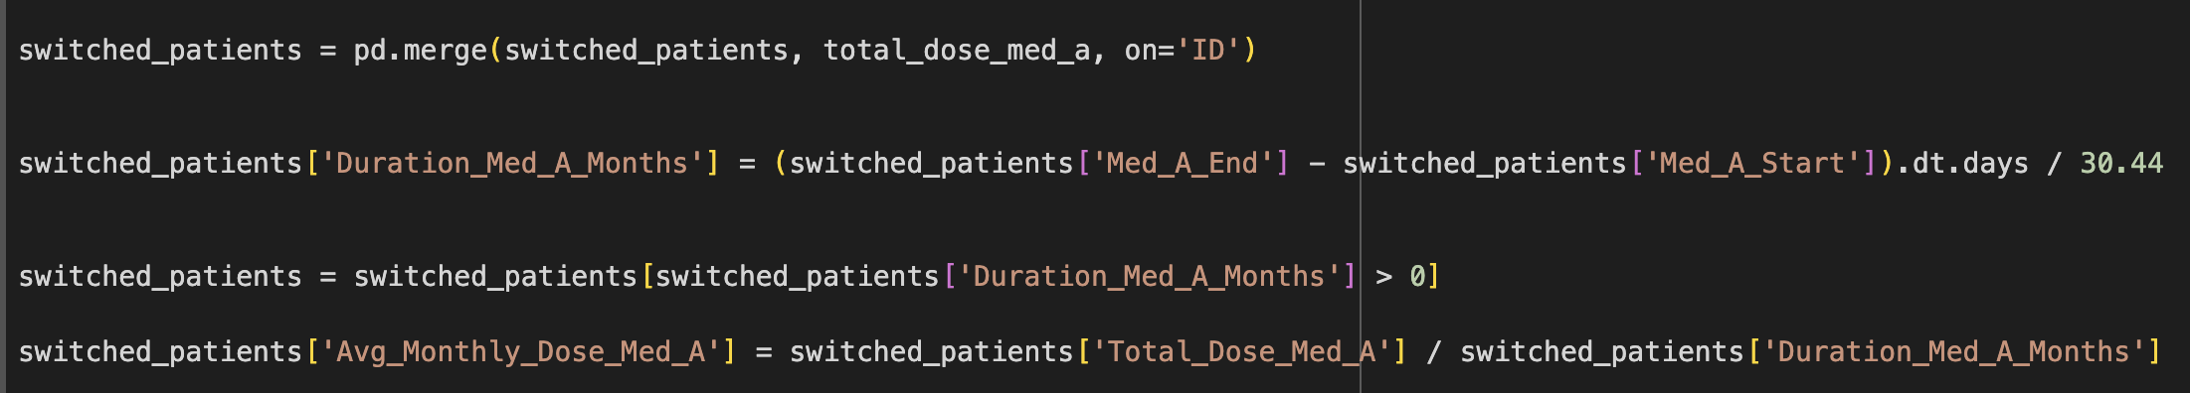
Question 6 - Average Monthly Dose Before and After Switching
Step 1
Step 2
Step 3
Step 4
Step 5
Step 6
Calculate the duration in months on Med A for each patient. Compute the average monthly dose for Med A:

Slide 19
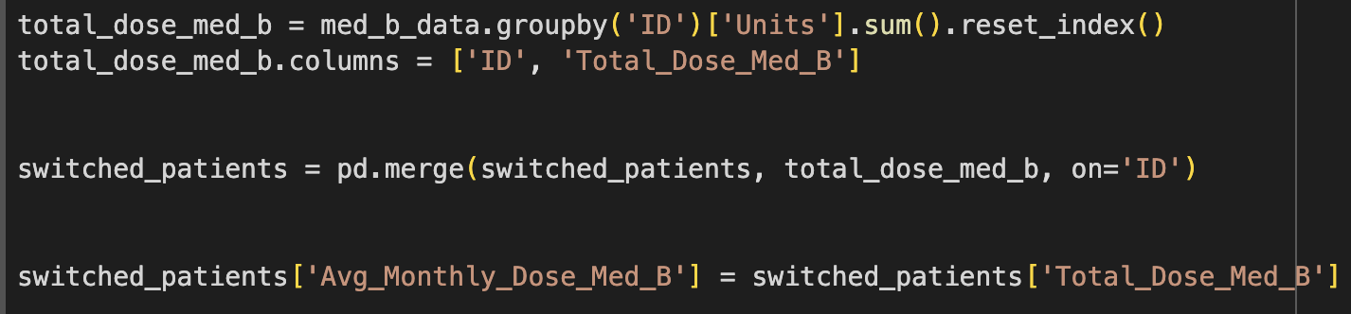
Question 6 - Average Monthly Dose Before and After Switching
Step 1
Step 2
Step 3
Step 4
Step 5
Step 6
Calculate the Monthly Dose for Med B After Switching : Filter the data for Med B.
Identify the first administration date for Med B for each patient. Calculate the total dose of Med B for each patient. Assume the dose for Med B is for one month. Merge the dose information with the patients who switched.

Slide 20
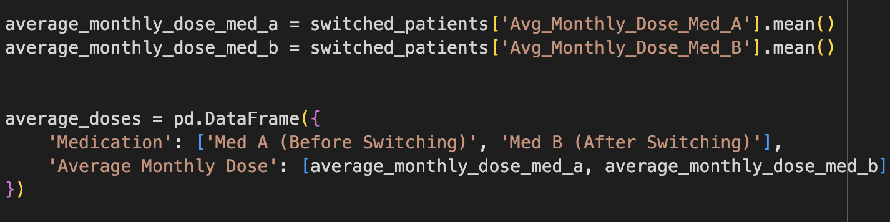
Question 6 - Average Monthly Dose Before and After Switching
Step 1
Step 2
Step 3
Step 4
Step 5
Step 6
Compute Averages for Each Patient : Calculate the average monthly dose for Med A before switching. Calculate the average monthly dose for Med B after switching.

Slide 21
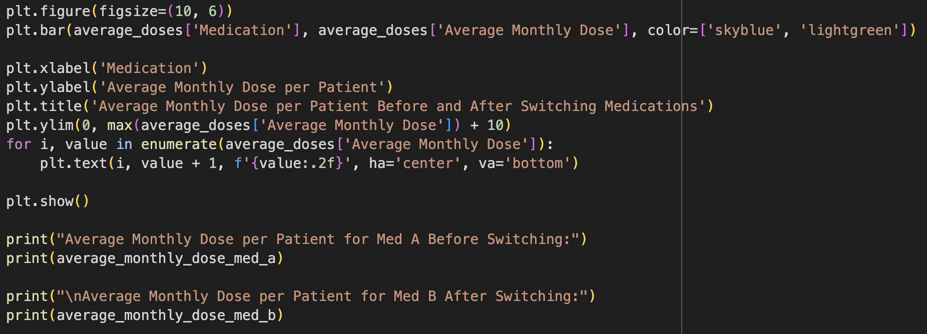
Question 6 - Average Monthly Dose Before and After Switching
Step 1
Step 2
Step 3
Step 4
Step 5
Step 6
Present the Results in a Table and Plot:

Slide 22
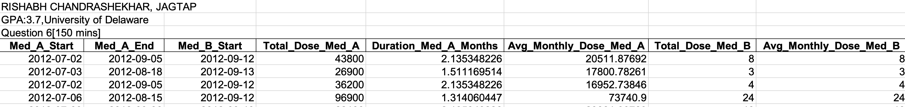
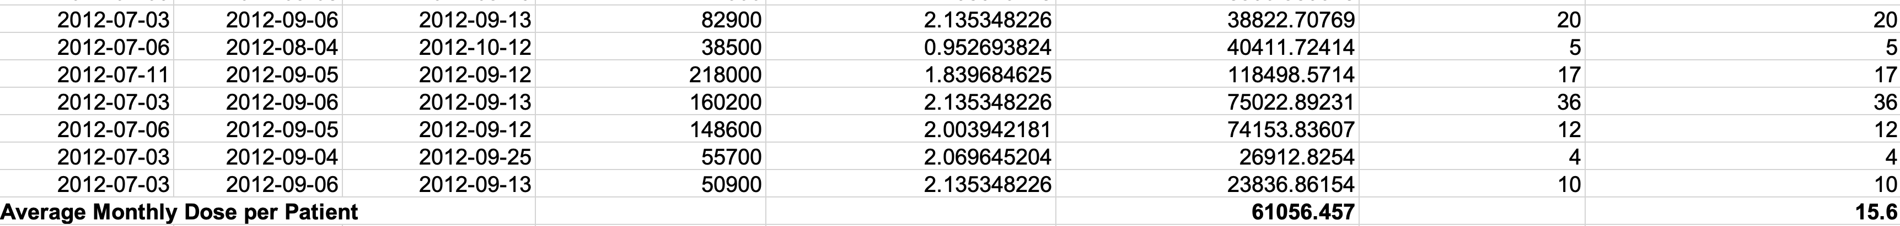
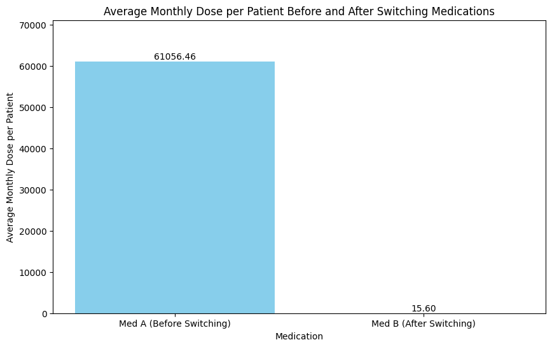
Question 6 - Average Monthly Dose Before and After Switching
Step 1
Step 2
Step 3
Step 4
Step 5
Step 6
Importing the answer in Excel:
Average Monthly Dose per Patient for Med A Before Switching: 61056.457
Average Monthly Dose per Patient for Med B After Switching: 15.6

Slide 23
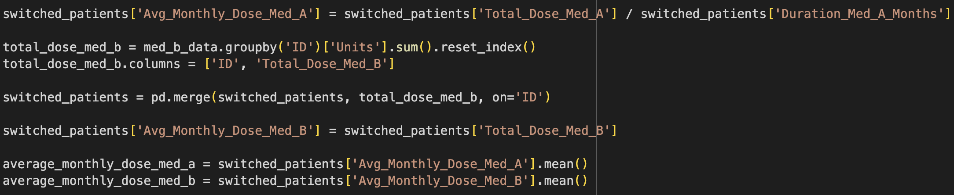
Question 7 - Breakeven Price Point for Med B
Step 1
Step 2
Step 3
Step 4
Calculate the average monthly dose for Med A and Med B:

Slide 24
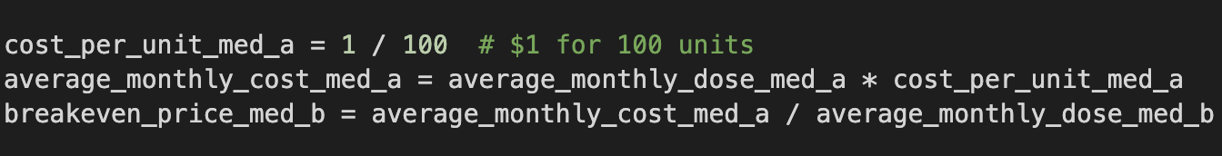
Question 7 - Breakeven Price Point for Med B
Step 1
Step 2
Step 3
Step 4
Use the given cost for Med A to compute the breakeven price for Med B:

Slide 25
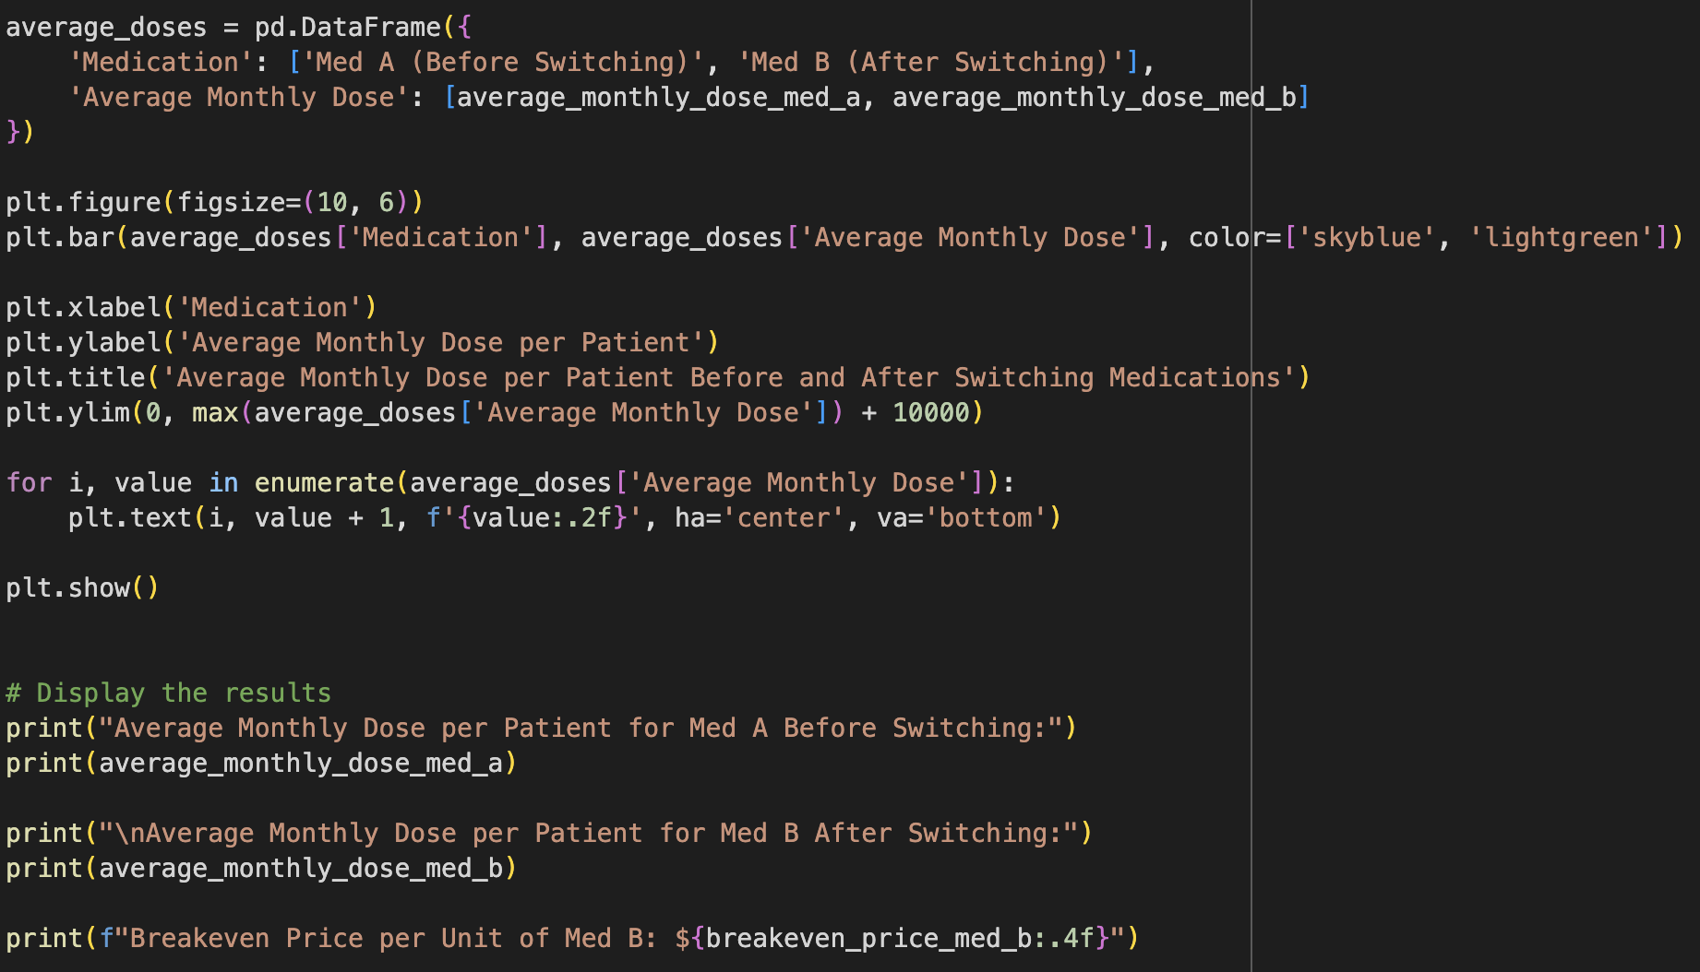
Question 7 - Breakeven Price Point for Med B
Step 1
Step 2
Step 3
Step 4
Display the breakeven price calculation:

Slide 26
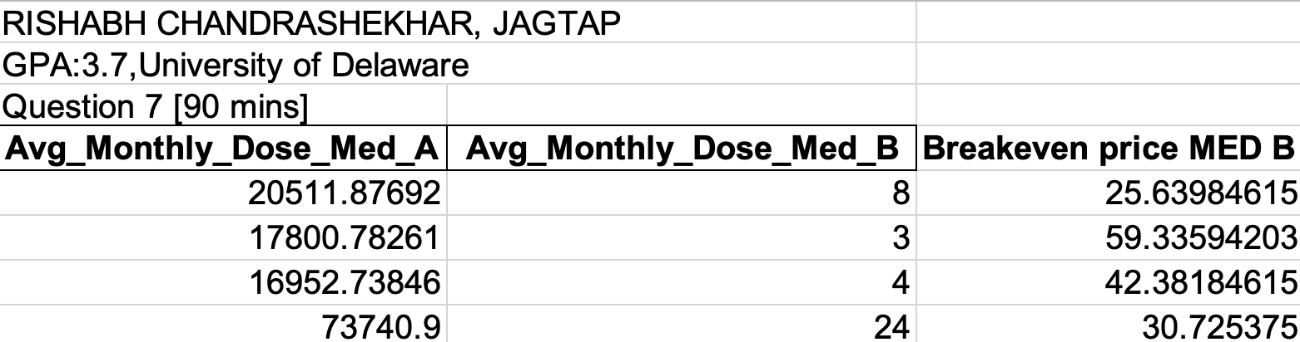
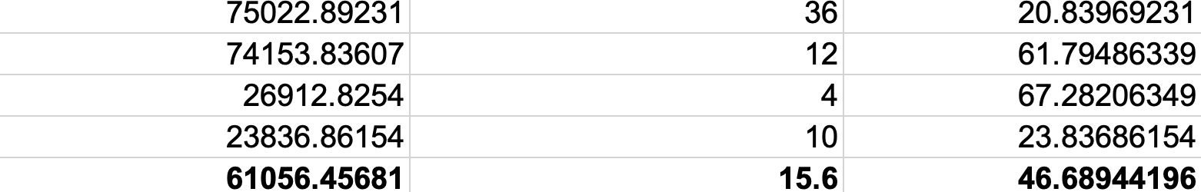
Question 7 - Breakeven Price Point for Med B
Step 1
Step 2
Step 3
Step 4
Importing the answer in Excel:
Breakeven Price per Unit of Med B: $46.68

Slide 27
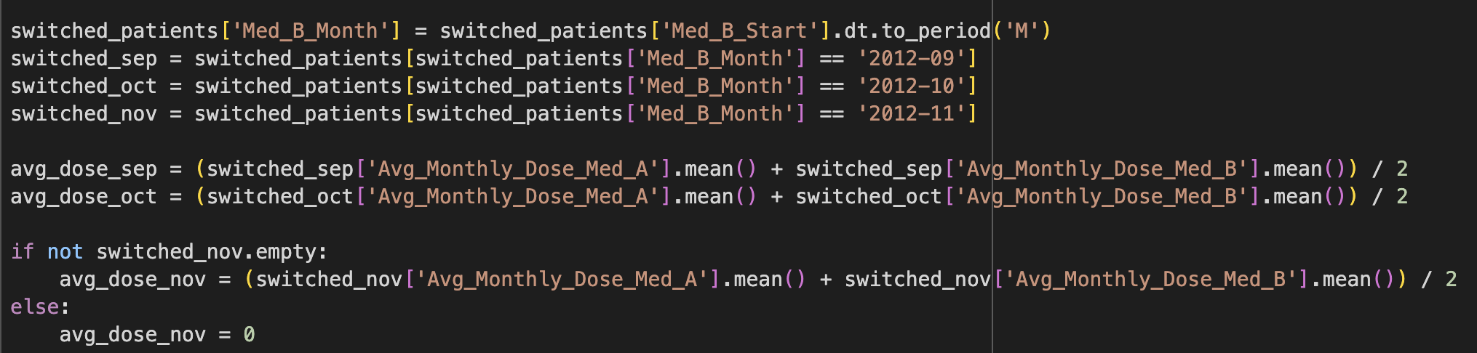
Question 8 - Change in Average Monthly Dose (Sept, Oct, Nov)
Step 1
Step 2
Step 3
Step 4
Calculate the average monthly dose for each month:

Slide 28
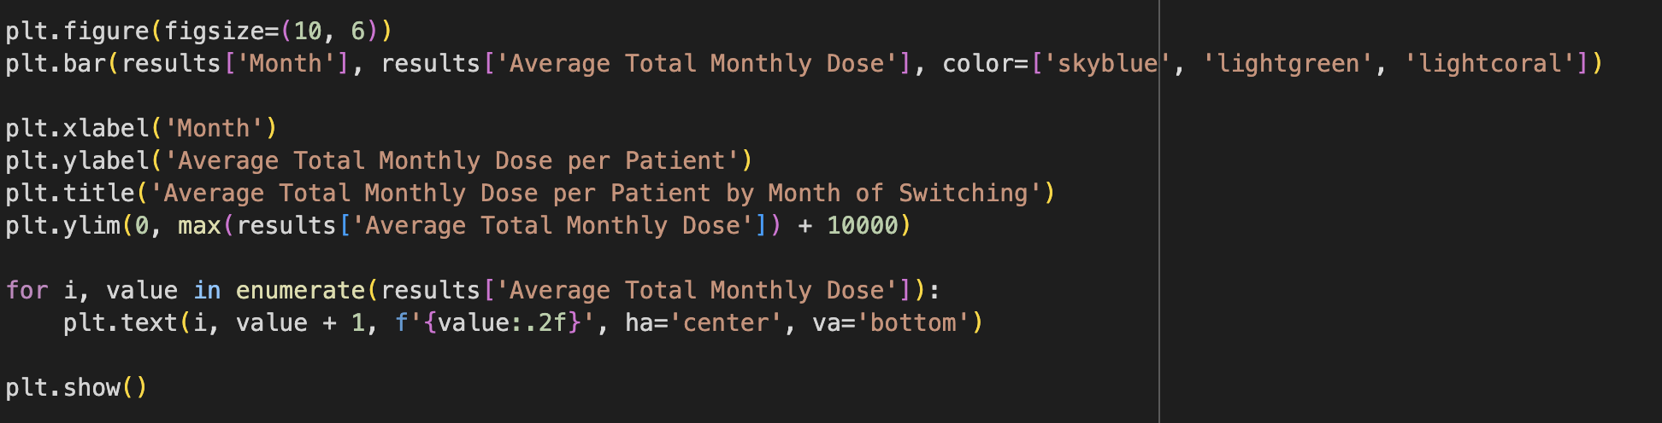
Question 8 - Change in Average Monthly Dose (Sept, Oct, Nov)
Step 1
Step 2
Step 3
Step 4
Compare the doses month-over-month:
Step 1
Step 2
Step 3
Step 4
Display the changes in a bar chart:

Slide 29
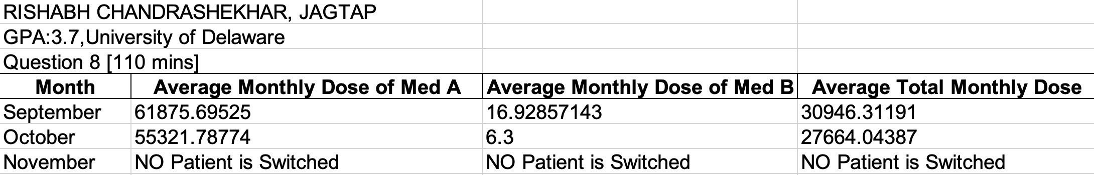
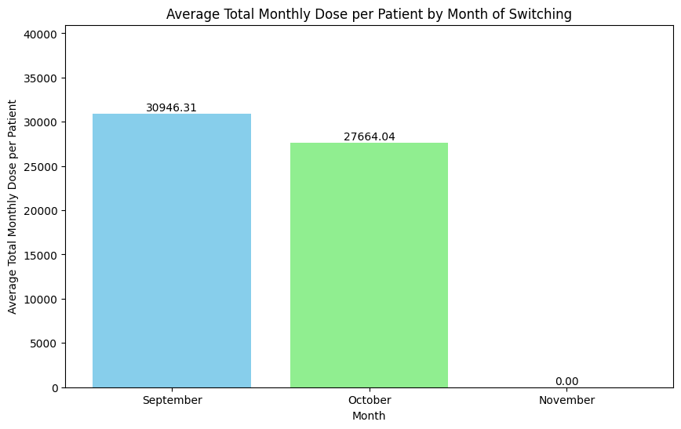
Question 8 - Change in Average Monthly Dose (Sept, Oct, Nov)
Step 1
Step 2
Step 3
Step 4
Importing the answer in Excel:

Slide 30
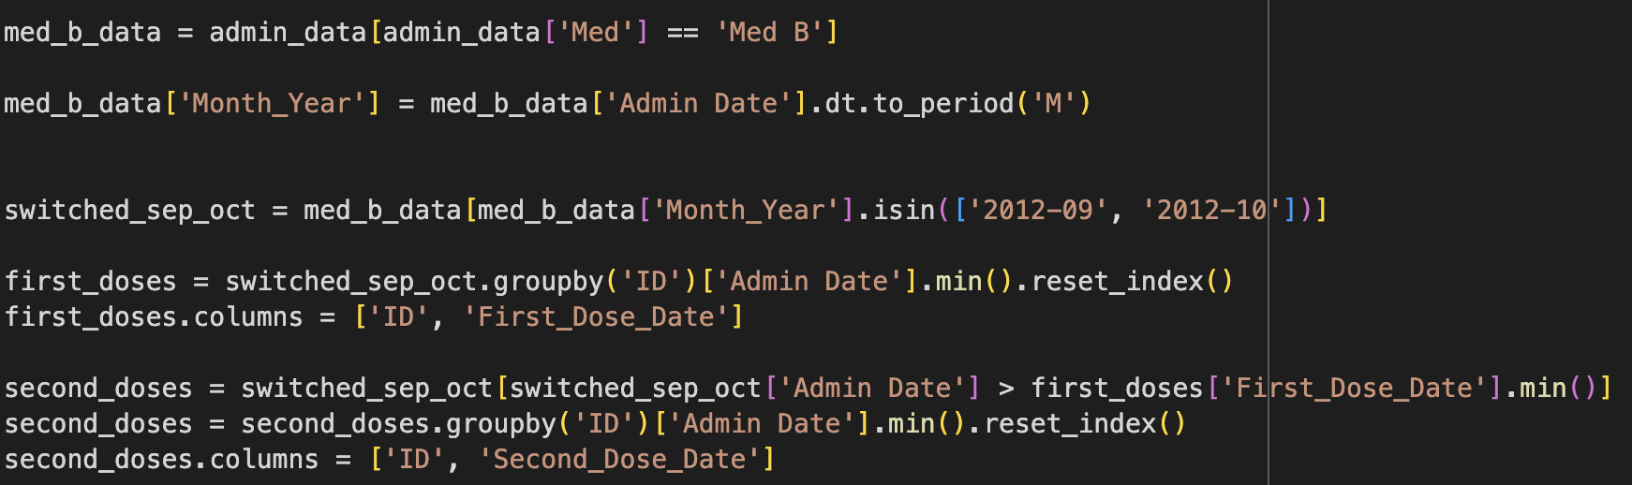
Question 9 – 2nd Med B Dose Comparison
Step 1
Step 2
Step 3
Step 4
Step 5
Identify the first and second doses of Med B: Add a column for the month and year of administration .Filter the data for patients who switched in September and October. Calculate the first and second dose for each patient:

Slide 31
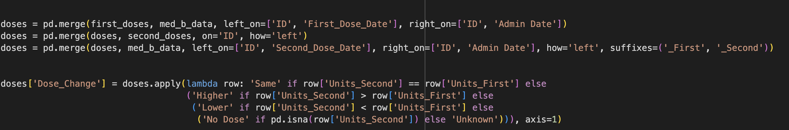
Question 9 – 2nd Med B Dose Comparison
Step 1
Step 2
Step 3
Step 4
Step 5
Merge the first and second dose dates with the original data. Determine dose changes:

Slide 32
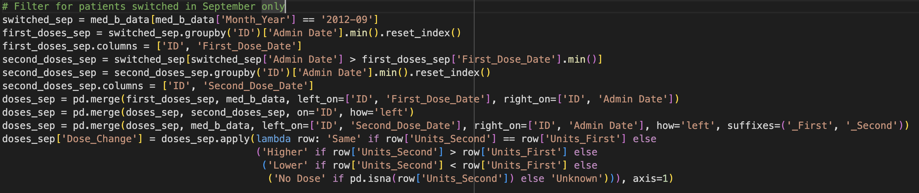
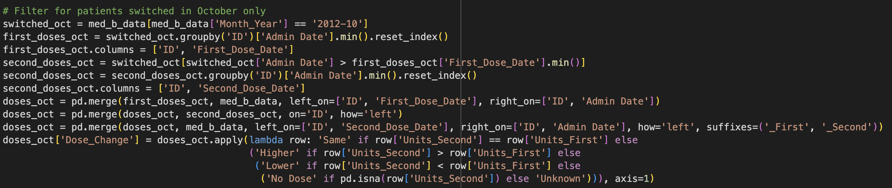
Question 9 – 2nd Med B Dose Comparison
Step 1
Step 2
Step 3
Step 4
Step 5
Filter for patients switched in September and October separately:

Slide 33
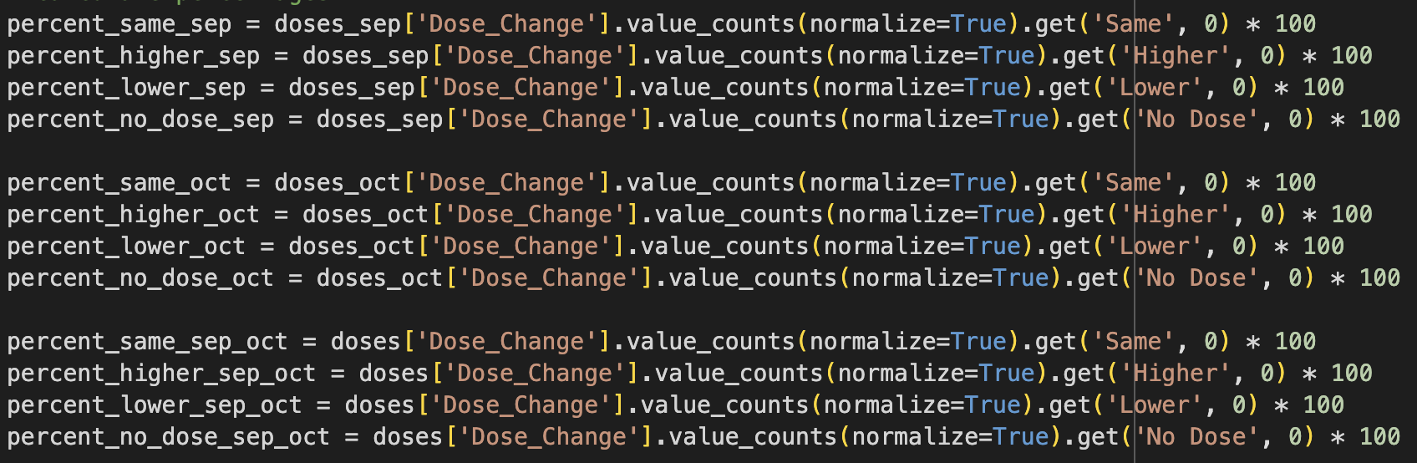
Question 9 – 2nd Med B Dose Comparison
Step 1
Step 2
Step 3
Step 4
Step 5
Calculate percentages for each September and October:

Slide 34
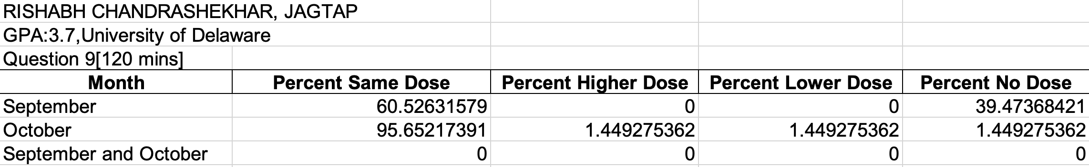
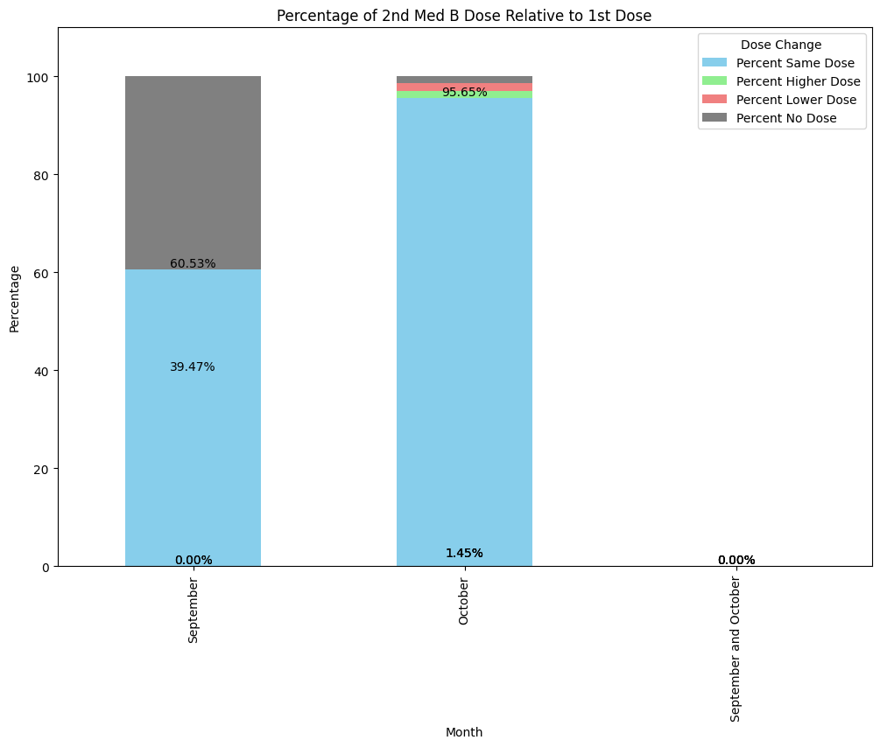
Question 9 – 2nd Med B Dose Comparison
Step 1
Step 2
Step 3
Step 4
Step 5
Importing the answer in Excel:

Slide 35
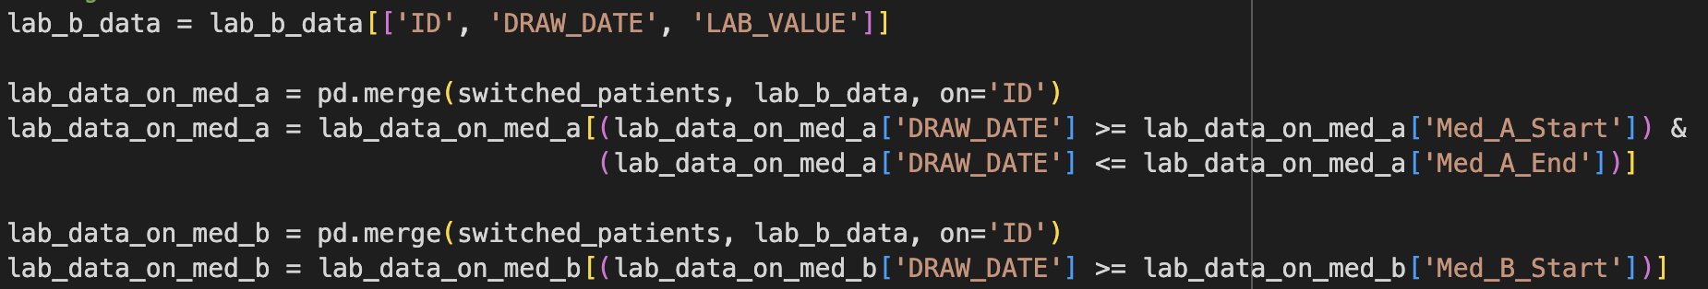

Question 10 - Average LAB B Values on Med A and Med B
Step 1
Step 2
Step 3
Step 4
Filter LAB B values for (September, October, and November) on Med A and Med B:
Step 1
Step 2
Step 3
Step 4
Calculate the average LAB B value for each medication period:

Slide 36
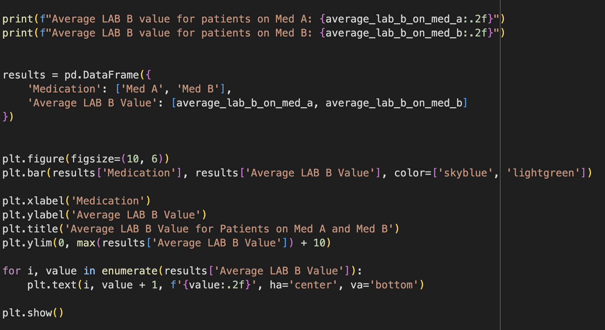
Question 10 - Average LAB B Values on Med A and Med B
Step 1
Step 2
Step 3
Step 4
Present the averages and plot the graph:

Slide 37
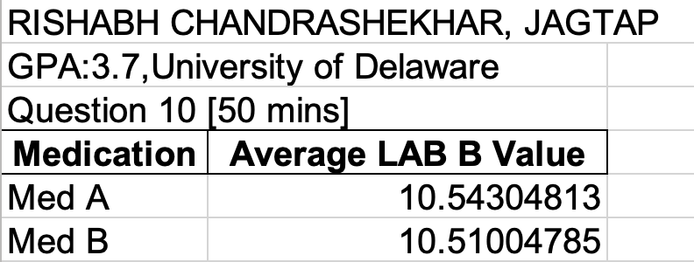
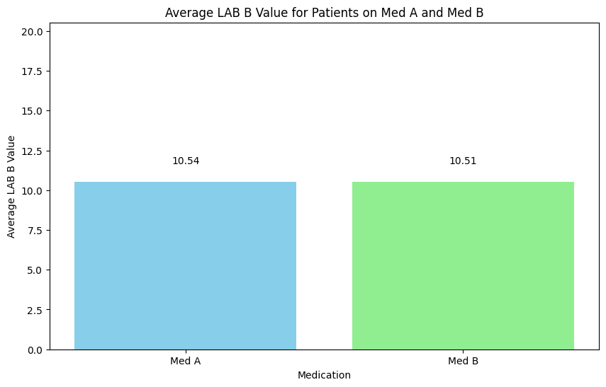
Question 10 - Average LAB B Values on Med A and Med B
Step 1
Step 2
Step 3
Step 4
Importing the answer in Excel:

Slide 38
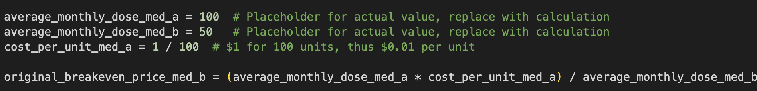
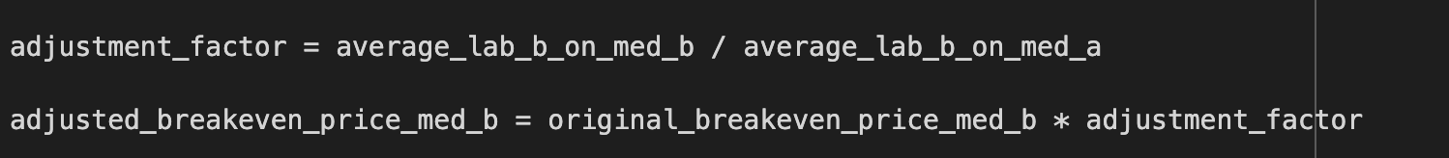
Question 11 - Impact on Breakeven Price Point
Step 1
Step 2
Step 3
Step 4
Determine the relationship between LAB B values and medication doses:
Step 1
Step 2
Step 3
Step 4
Adjust the breakeven price calculation based on LAB B value differences:
Step 1
Step 2
Step 3
Step 4
Display the results:

Slide 39
Question 11 - Impact on Breakeven Price Point
Step 1
Step 2
Step 3
Step 4
Importing the answer in Excel:

